Slide 1
Advancing Progression Management
A Design Thinking Exploration
Hosts: Danielle Beetge & Robyn Harris | Session 80-82

Slide 2
Agenda
Best practice
What are your pain points?
Process: beginning to end
How are you measured?

Slide 3
Best practices are sets of methods and techniques that produce optimal results, increase efficiency and develop structured processes.

Slide 4
Easier to learn
Faster to use
Cheaper to develop
Creates supportive community

Slide 5
Easier to learn
Faster to use
Cheaper to develop
Creates supportive community

Slide 6
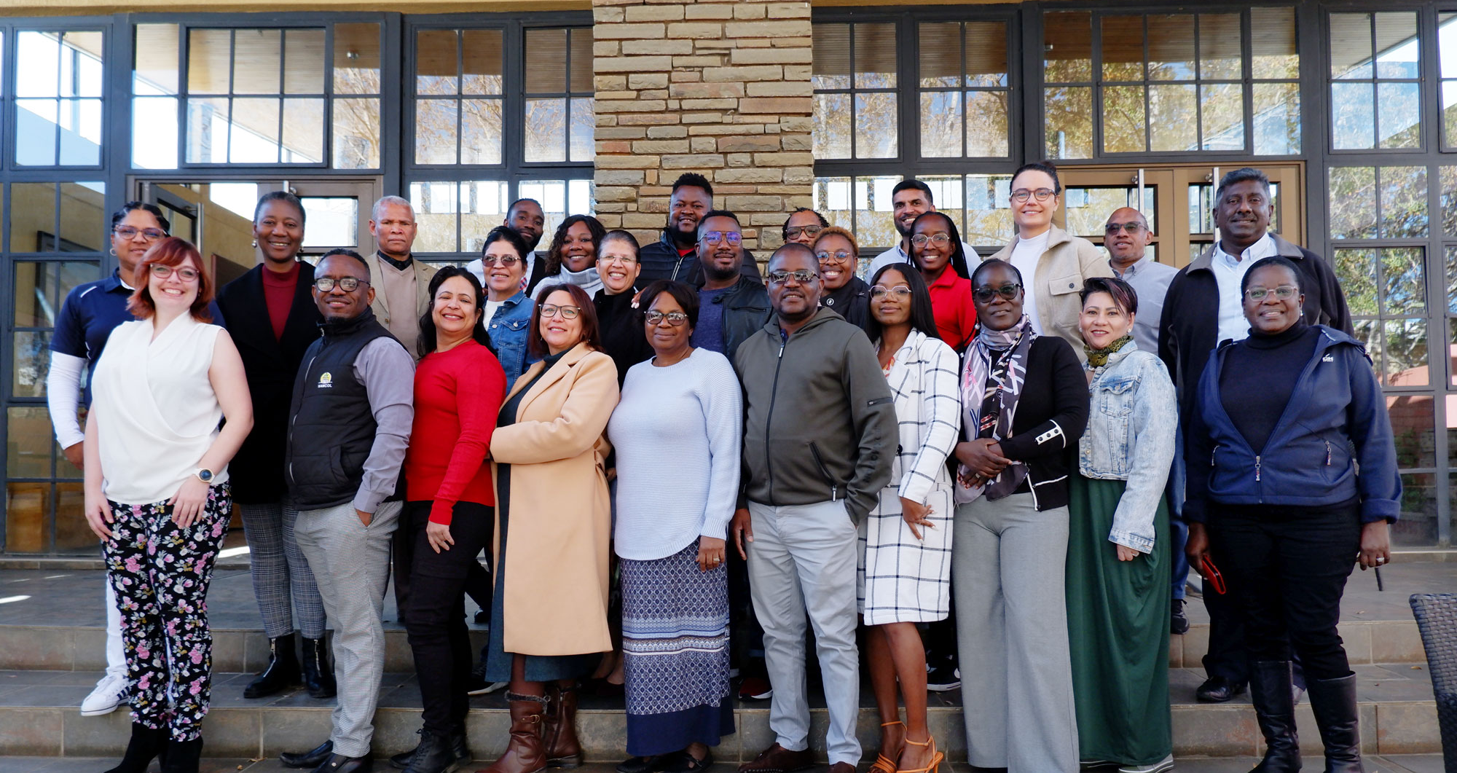
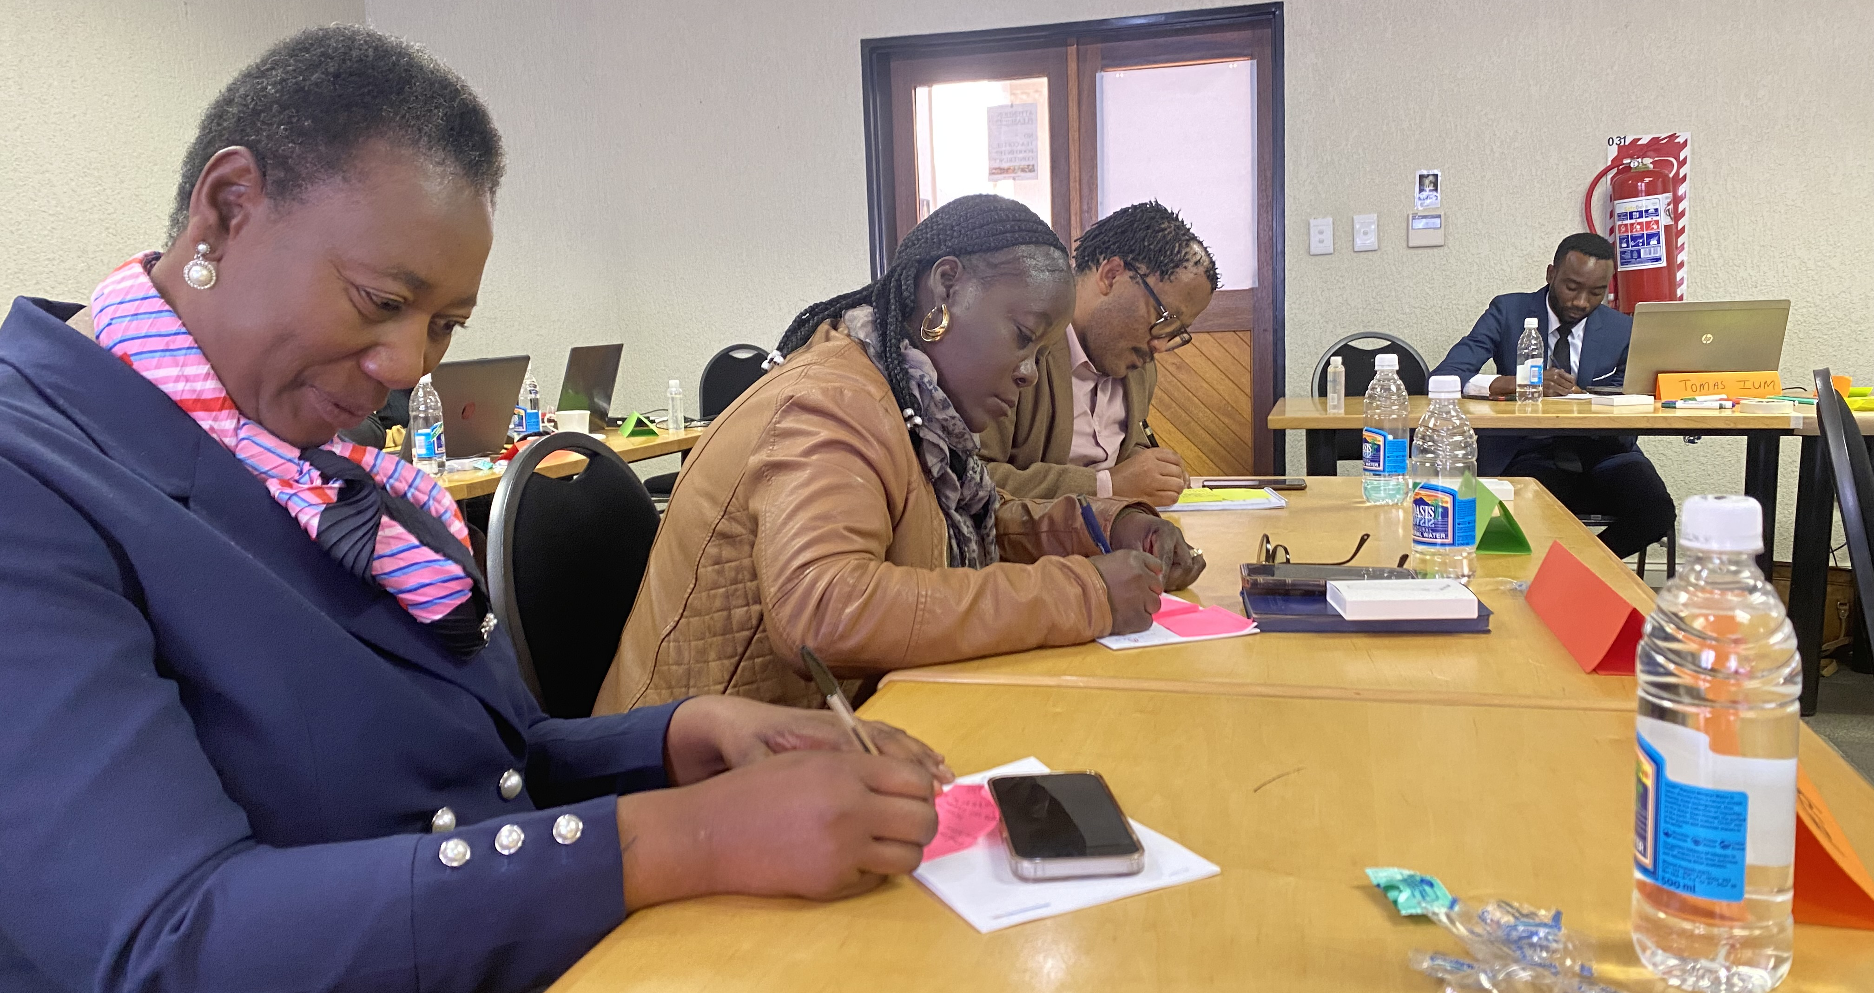
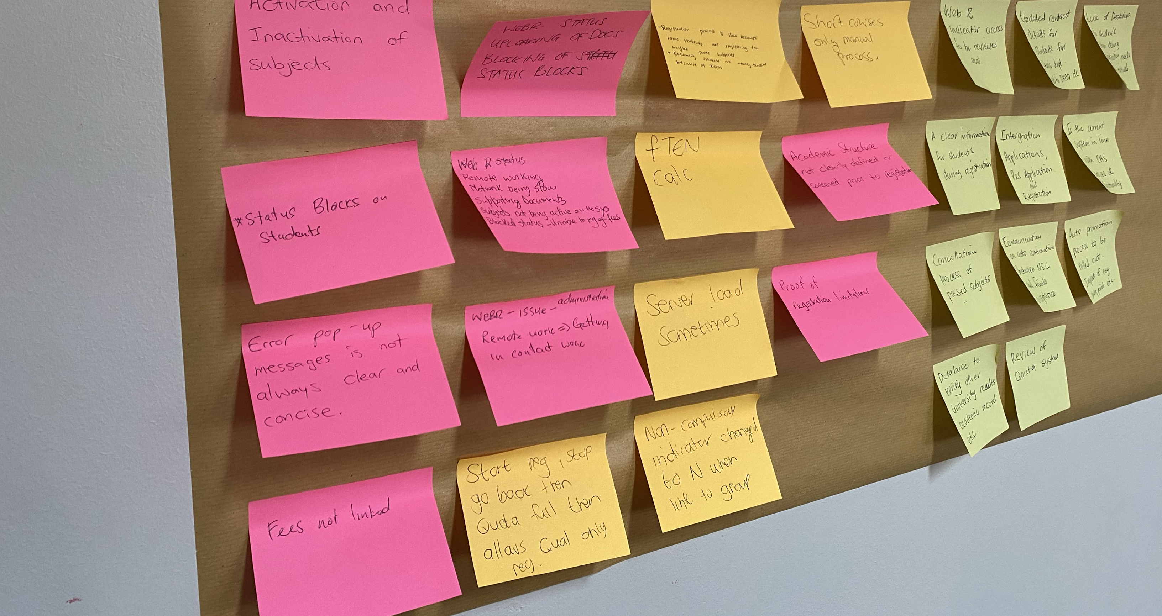
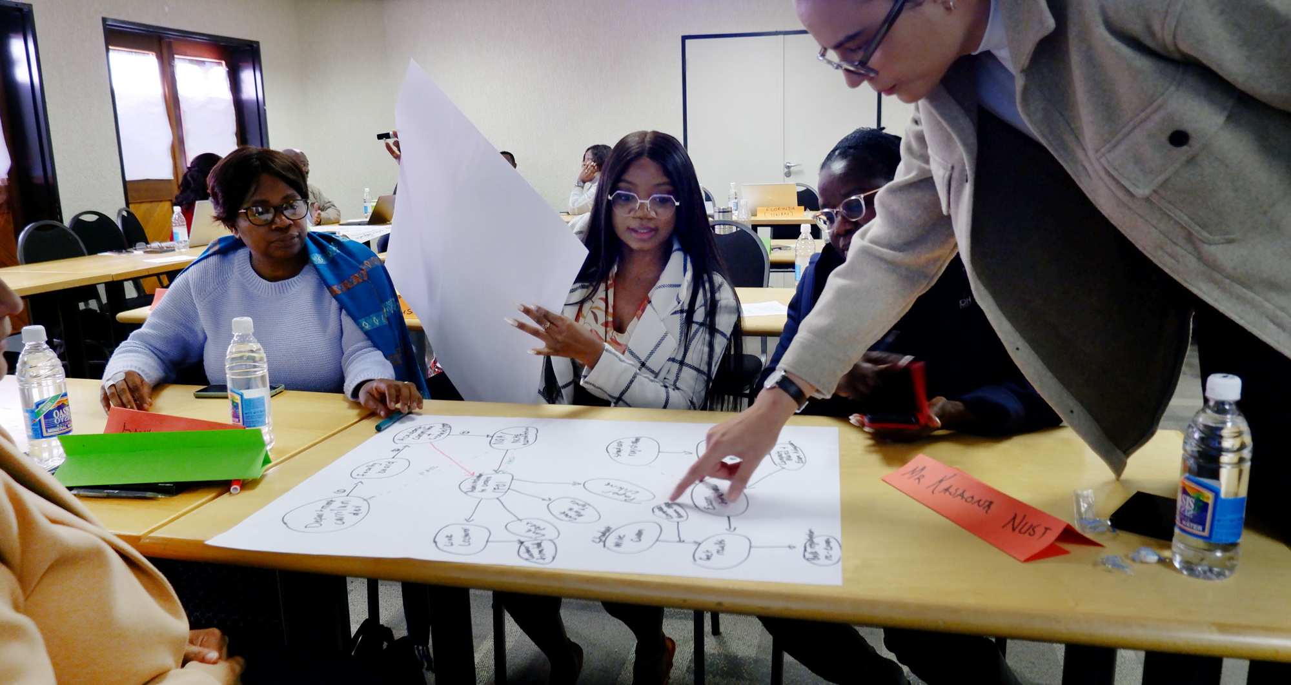
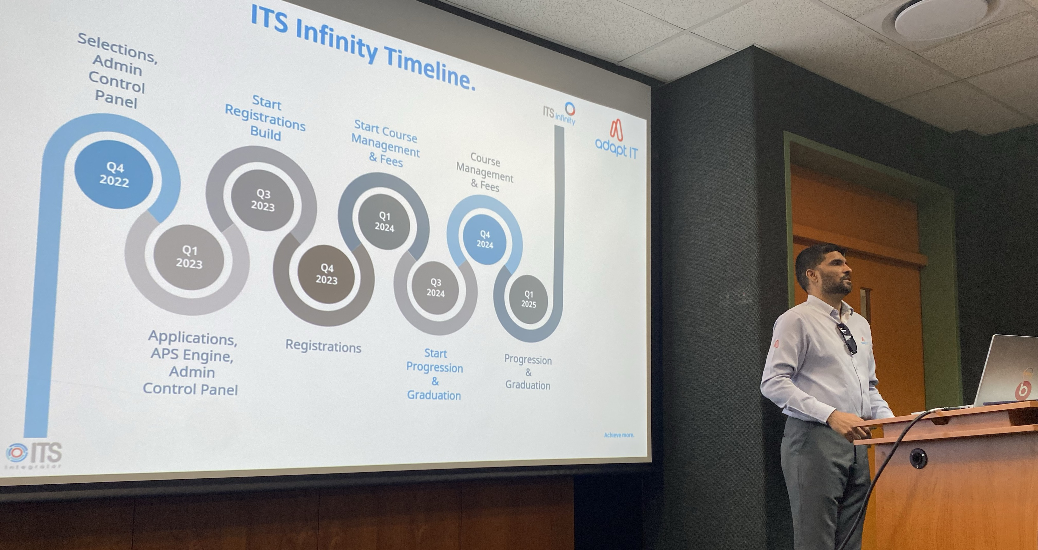
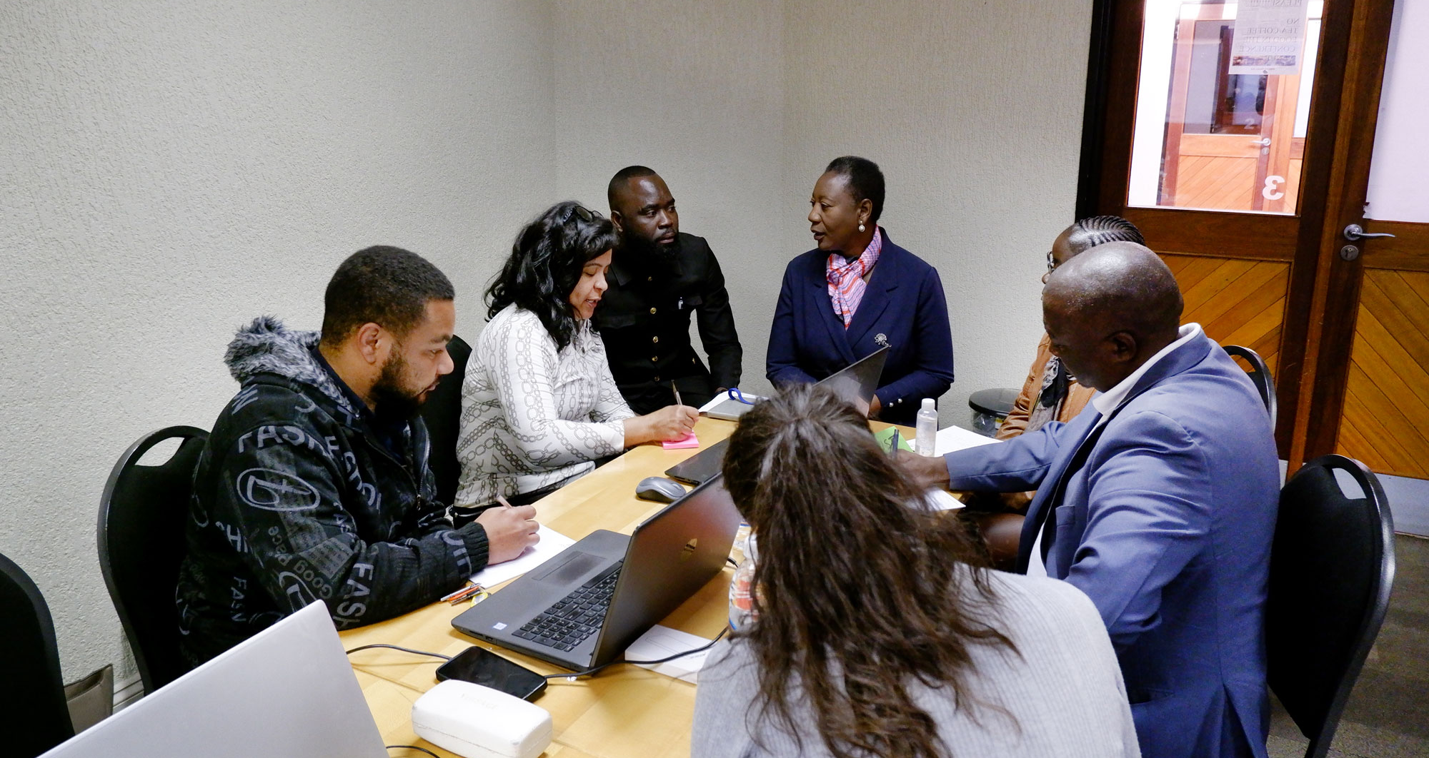
You are now part of that community

Slide 7
Personas Involved
Applications Manager
Registration Officer
Admissions Officer
Enrolment Manager
Faculty Officer
Administrative Assistant
Graduation Officer
Deputy Registrar
Manager: Assessment & Graduation
Manager: Postgraduate Assessments

Slide 8
What are your pain points regarding progression management?
Join at menti.com | use code 4676589

Slide 9
No clear visible overview
No clear communication
No way of knowing/seeing, after setup, what is still pending and what effects what where.
No clear step by step flow everything is jumbled, jump between menu options
If there is a change made that effects us we have know way of instantly knowing
Incorrect or contradictory rules result in a student not graduating. Registration, graduation and progression rules need to be aligned.
Other dependencies not setup correctly (quotas, academic structure etc.)
Usability
System
Maintaining the rules is too difficult, the way how we create rules needs to be simplified
We don’t know what impacts what and why
No way to effectively transfer the student from old qualification to newly changed qualification, linkage is difficult. This is where the issue comes with student not being able to graduate.
Do not know how to capture their rules in the system so that it makes sense, system is very technical.

Slide 10
Process: Beginning to End

Slide 11
What does your business processes look like?
Join at menti.com | use code 4676589
Notes:
Pre-checklist “Auto Progress” should be set to "Y" {SSTUDD-2} Criteria per Period of Study. A Census Record for the year to which the students should be promoted must exist on {GOPS-1}. The Academic Structure must exist for the year to which the student will be promoted to. The event codes P1 and P2 must be linked to applicable admission status codes in {SCAO1-6} Result Code indicators should be set up in {SCODE-23}. Specify if the result code Period of Study sequences should be set up carefully in {SCODE-30}. The "Pre-requisites" qualifications should be set up carefully in {SACADO-6}. A Census Record for the year and block code to which the students should be promoted must exist on {GOPS-1}. Set QU validation on {SMNT-1} to determine if quota should be checked (Y) or not (N) on {SACADO-5}

Slide 12
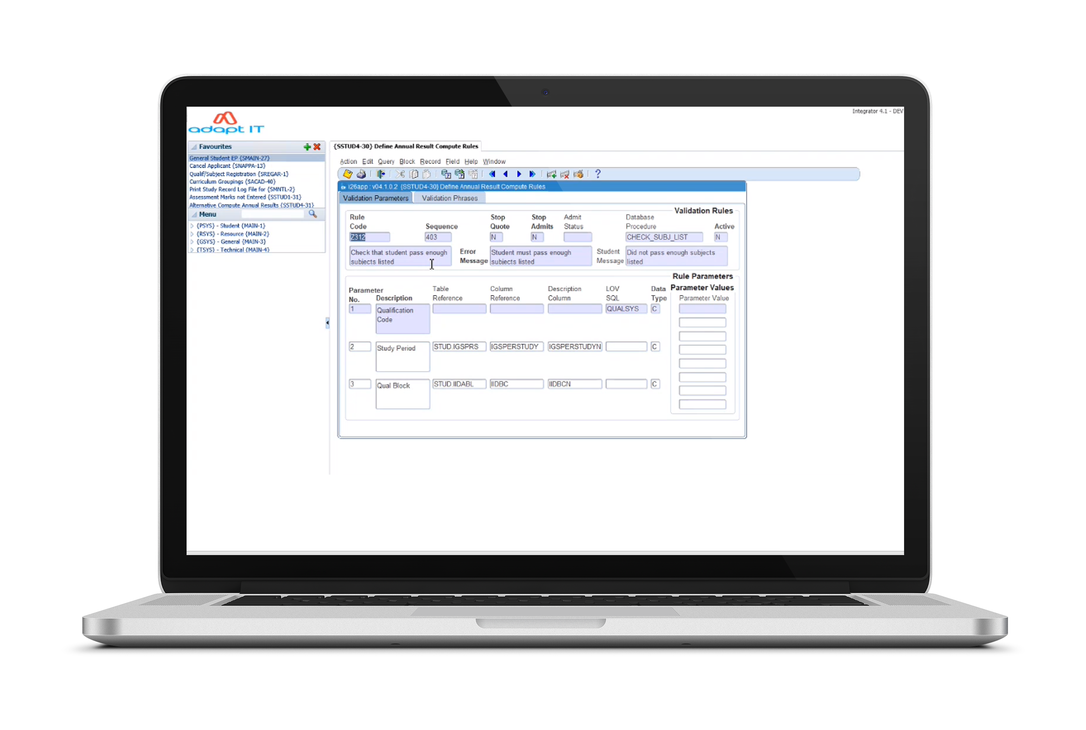
ARC Process
{SSTUD4-30}
Define Annual Result Compute Rules

Slide 13
ARC Process
{SSTUD4-30}
Define Annual Result Compute Rules

Slide 14
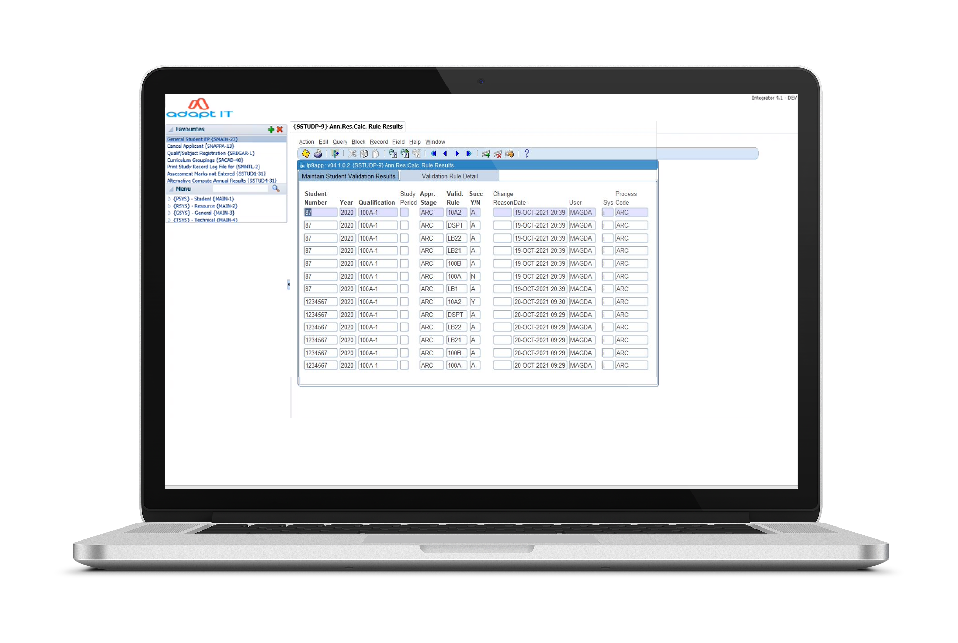
ARC Process
{SSTUDP-9}
Annual Result Calculation Results

Slide 15
ARC Process
{SSTUDP-9}
Annual Result Calculation Results

Slide 16
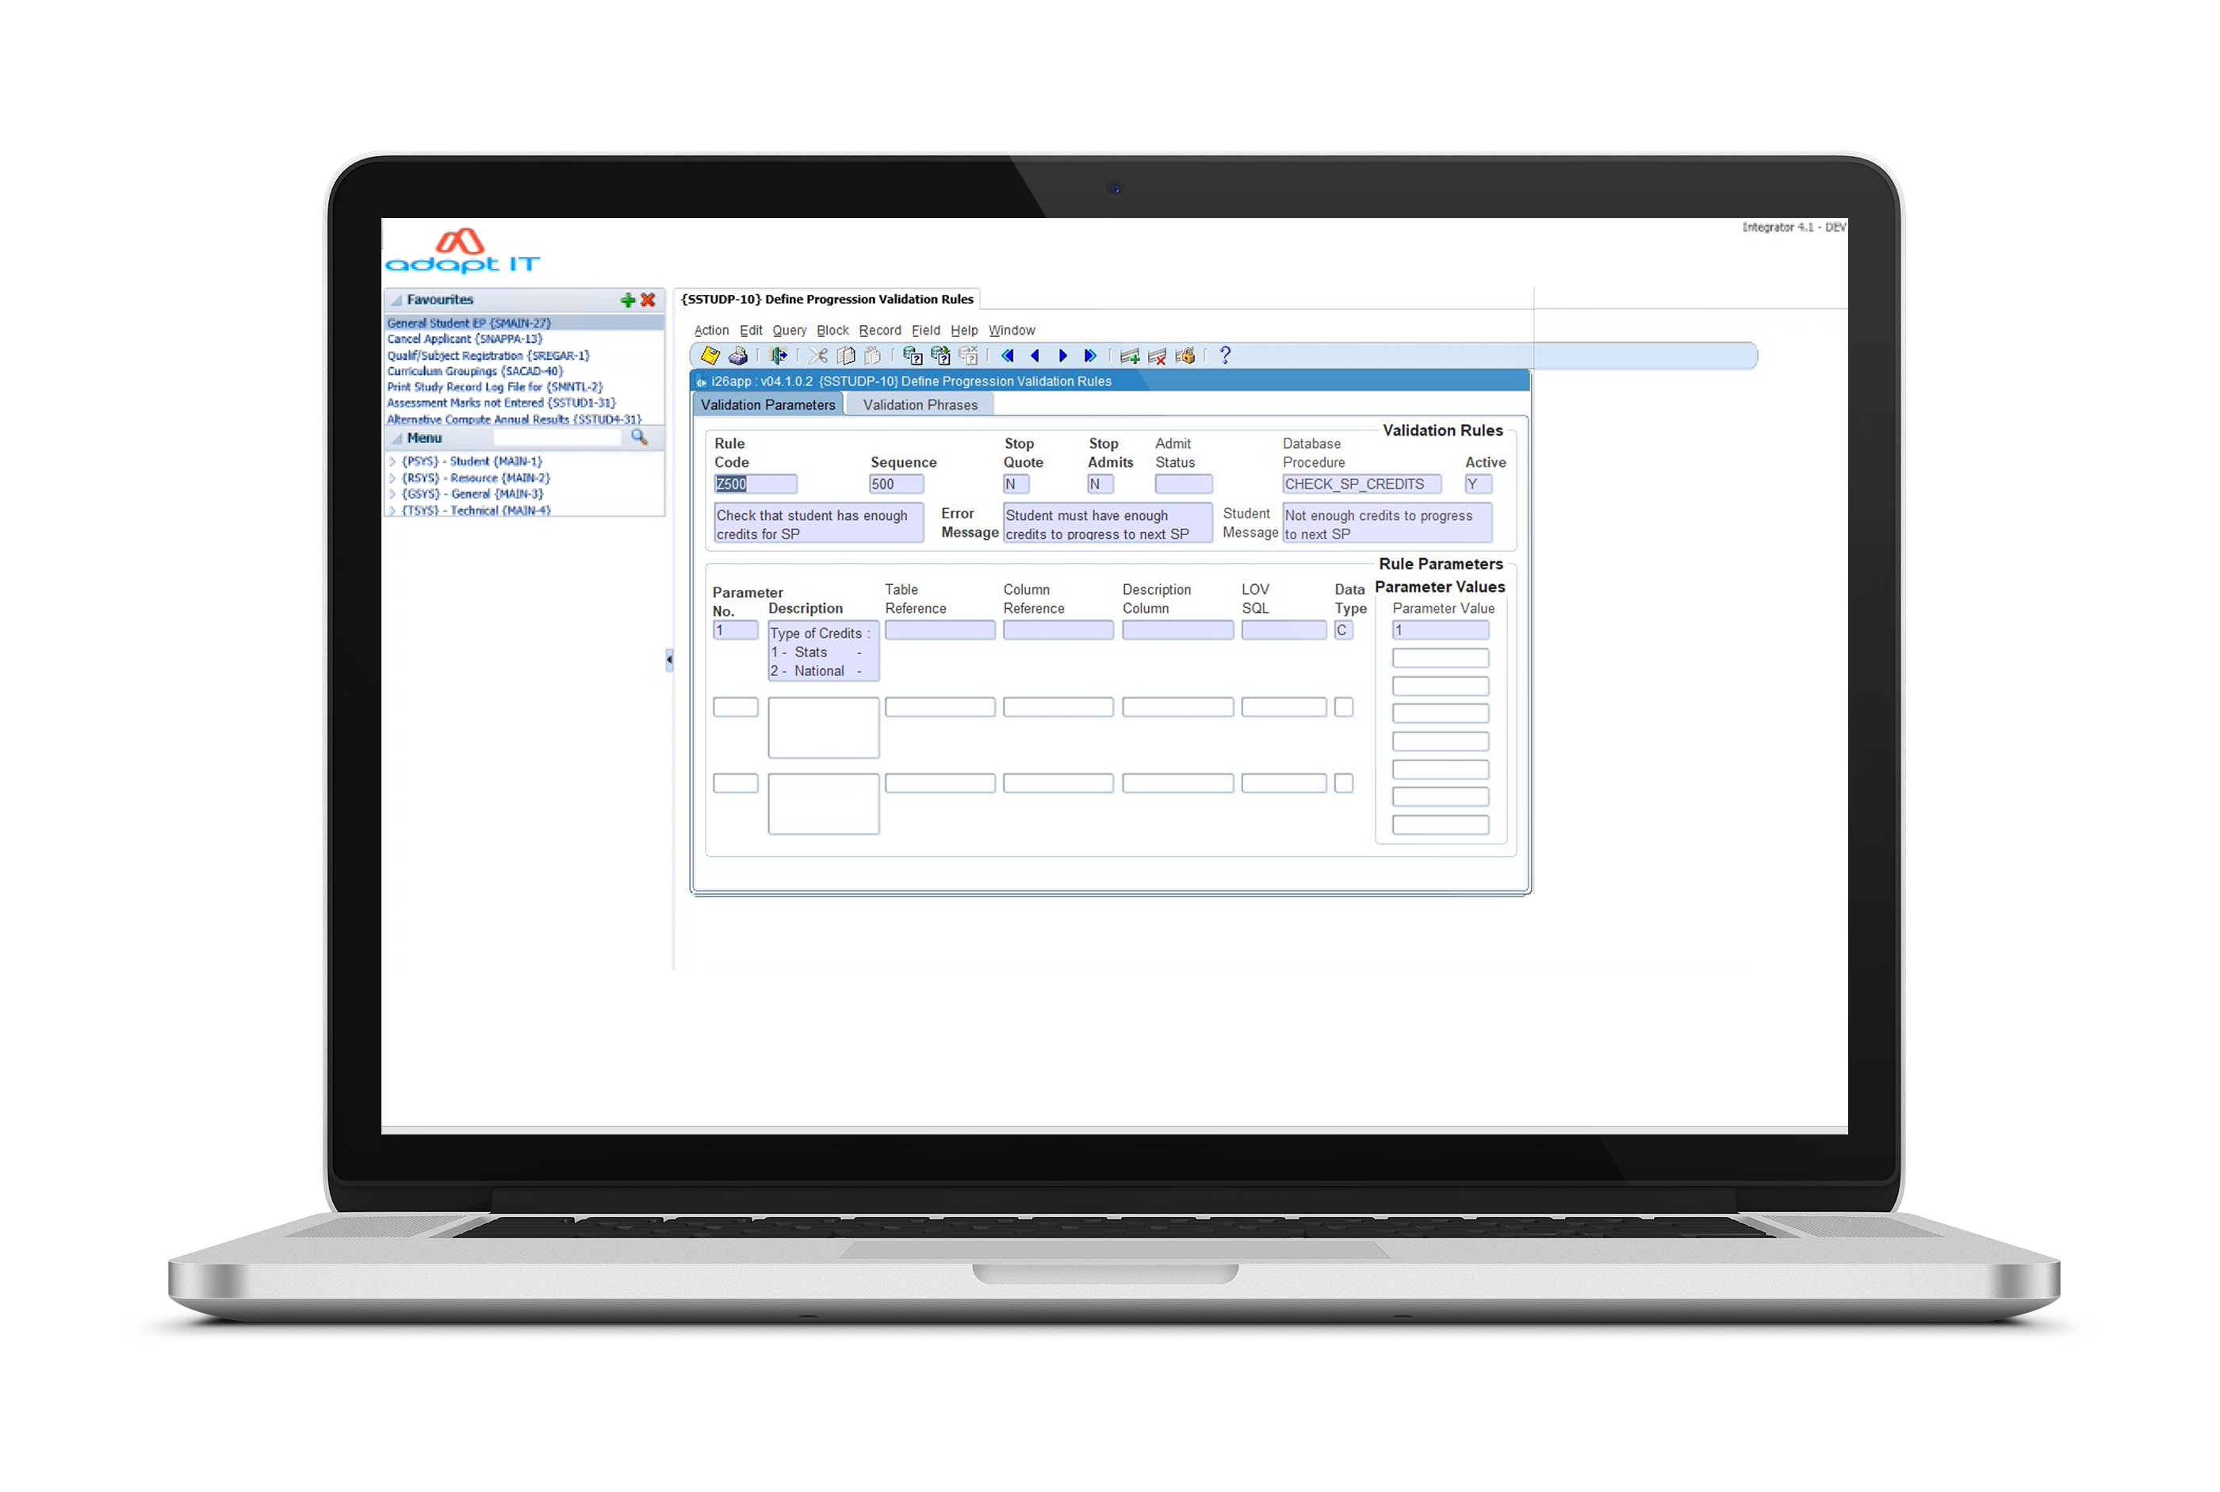
PRGV Process
{SSTUDP-10}
Progression Validation Rules

Slide 17
PRGV Process
{SSTUDP-10}
Progression Validation Rules

Slide 18
PROG Process
{SSTUDP-14}
Maintain Auto Progression Stage Codes

Slide 19
PROG Process
{SSTUDP-14}
Maintain Auto Progression Stage Codes

Slide 20
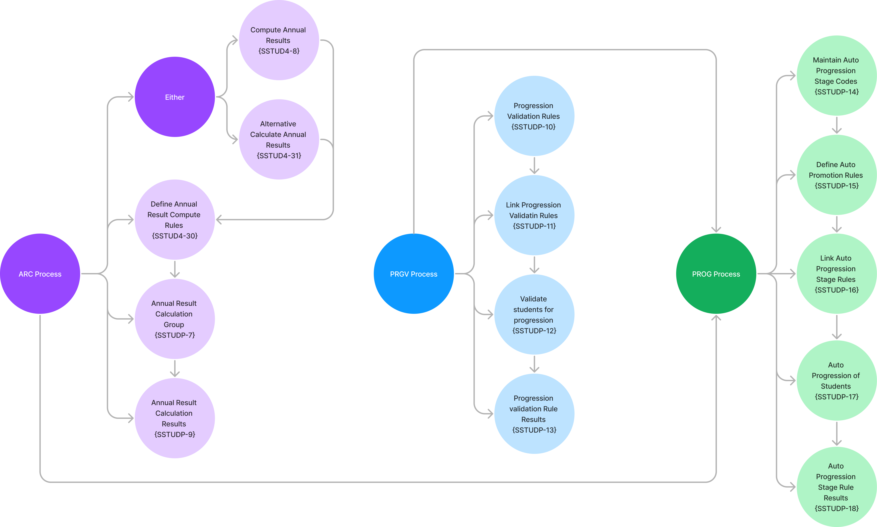

Slide 21
ARC Process Dependencies
PRGV Process Dependencies
PROG Process Dependencies
Maintain Curriculum Structure {SACADO-17}
Define and Maintain a Subject {SACADO-10}
Subject Requisite Types {SACADO-14}
Valid Subject Group Combinations {SACAD-11}
Student Promotions {SSTUDD-3}
Criteria per Study Period {SSTUDD-2}
Query Student Qualification and Subject Information {SSTUDA-7}
Student Annual Results {SSTUD7-2}
Criteria per Study Period {SSTUDD-2}
Maintain Result Codes {SCODE-23}
Maintain Periods of Study {SCODE-30}
Maintain Qualification Requisite Types {SACADO-6}
Census Dates {GOPS-1}
Define and Maintain Qualification Study Periods {SACADO-5}
Progression Validation Rules are defined on {SSTUDP-10}
The linking of Progression Validation Rules are defined on {SSTUDP-11}
Run program {SSTUDP-12} or {SSTUDP-17} for the validation of Students for Progression

Slide 22
Draw out your business process.
10 min - Group

Slide 23
What do need to report on?
Join at menti.com | use code 4676589
Notes:
Pre-checklist “Auto Progress” should be set to "Y" {SSTUDD-2} Criteria per Period of Study. A Census Record for the year to which the students should be promoted must exist on {GOPS-1}. The Academic Structure must exist for the year to which the student will be promoted to. The event codes P1 and P2 must be linked to applicable admission status codes in {SCAO1-6} Result Code indicators should be set up in {SCODE-23}. Specify if the result code Period of Study sequences should be set up carefully in {SCODE-30}. The "Pre-requisites" qualifications should be set up carefully in {SACADO-6}. A Census Record for the year and block code to which the students should be promoted must exist on {GOPS-1}. Set QU validation on {SMNT-1} to determine if quota should be checked (Y) or not (N) on {SACADO-5}

Slide 24
Contributors​
Pravie Govender Pravie.Govender@adaptit.com
Clinton Naidu Clinton.Naidu@adaptit.com
Linda Putu linda.putu@adaptit.com
Thato Mthembu Thato.Mthembu@adaptit.com
David Goodrum
david.goodrum@adaptit.com
Shannon Naidoo Shannon.Naidoo@Adaptit.com
Claire Marais
claire.marais@adaptit.com
Danielle Beetge Danielle.Beetge@adaptit.com
Robyn Harris
robyn.harris@adaptit.com

